Slide 1


Slide 2

F# Primer for C# Developers
https://github.com/srpeterson/fsharp-csharp-developers

Slide 3



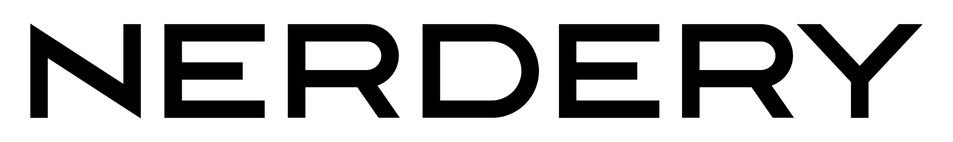
Steve Peterson
The Nerdery
Stephen.Peterson@outlook.com
Twitter: @steverpeterson
(all the code, info and slides)
https://github.com/srpeterson/fsharp-csharp-developers

Slide 4
What’s on the menu…
Introduction to F#
Functional C# language features
Direct comparison of F# and C#
Soo.. Why use F#?
F# Resources
Conclusion
Disclaimer!!!
This goal of this talk is not to teach you F#.
But rather…
https://github.com/srpeterson/fsharp-csharp-developers

Slide 5
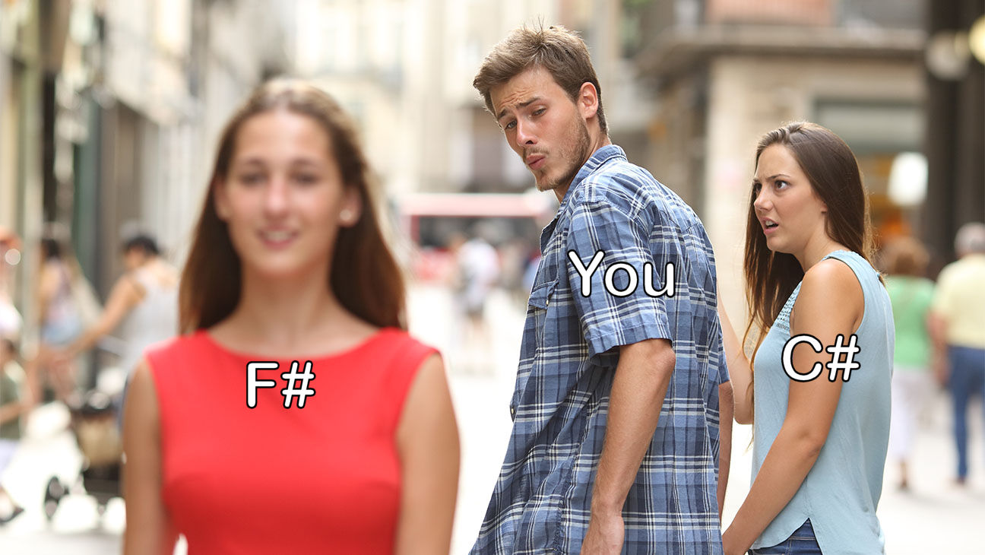
https://github.com/srpeterson/fsharp-csharp-developers

Slide 6

Introducing F#
First shipped with Visual Studio 2010
First class citizen of the .NET language family
Is a functional first language
Is open source
Fully interoperable with C# libraries and vice versa
https://github.com/srpeterson/fsharp-csharp-developers

Slide 7
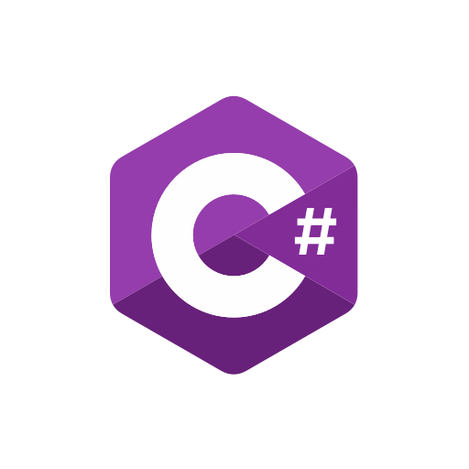
Evolution of C#
LINQ
Anonymous Functions
Lambda Expressions
Extension Methods
Value type tuples
Pattern Matching
Expression Bodies
Inline methods
Nullable Reference Types
Switch Expressions
Default Interface Methods
Indices and Ranges
https://github.com/srpeterson/fsharp-csharp-developers

Slide 8
Comparing C# to F#
Object Oriented (OOP)
Mutable by default
Reference typed
Private by default
No dependency order
Functional language
Immutable by default
Static Value typed
Public by default
Enforced dependency order
More examples to come…
https://github.com/srpeterson/fsharp-csharp-developers

Slide 9
Comparing C# to F#
Imperative
Classes to hold data
Interfaces
Inheritance
Declarative
Record Types
Higher order functions
Nope!! Open what ya need!
More examples to come…
https://github.com/srpeterson/fsharp-csharp-developers

Slide 10
Comparing C# to F#
Huh???
No clue, sir!
What the…???
No way!! Really???
Algebraic Type System (And/Or)
Option Type (Some/None)
Result Type (Ok/Error)
Units of Measure
On to actual code…!
https://github.com/srpeterson/fsharp-csharp-developers

Slide 11
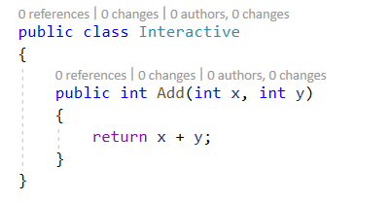
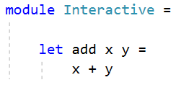
Basic Syntax
7 lines code
60 characters
3 lines code
29 characters
https://github.com/srpeterson/fsharp-csharp-developers

Slide 12
C# Interactive vs F# Interactive
Exists, but rather clumsy
Man, I’m jealous!!
Easy to use
Script (.fsx) files
https://github.com/srpeterson/fsharp-csharp-developers

Slide 13
Soo.. Why use F#?
Never have to worry about nulls!
Less and more succinct code
Compiler enforces correct code
F# Interactive allows you to test code as you write it
Self documenting code
Focus on “what” not the “how”
Less time to production
Makes you a better C# developer!
https://github.com/srpeterson/fsharp-csharp-developers

Slide 14
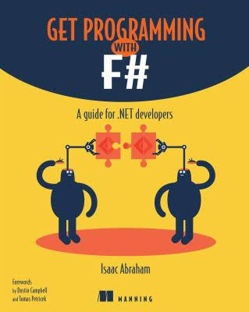
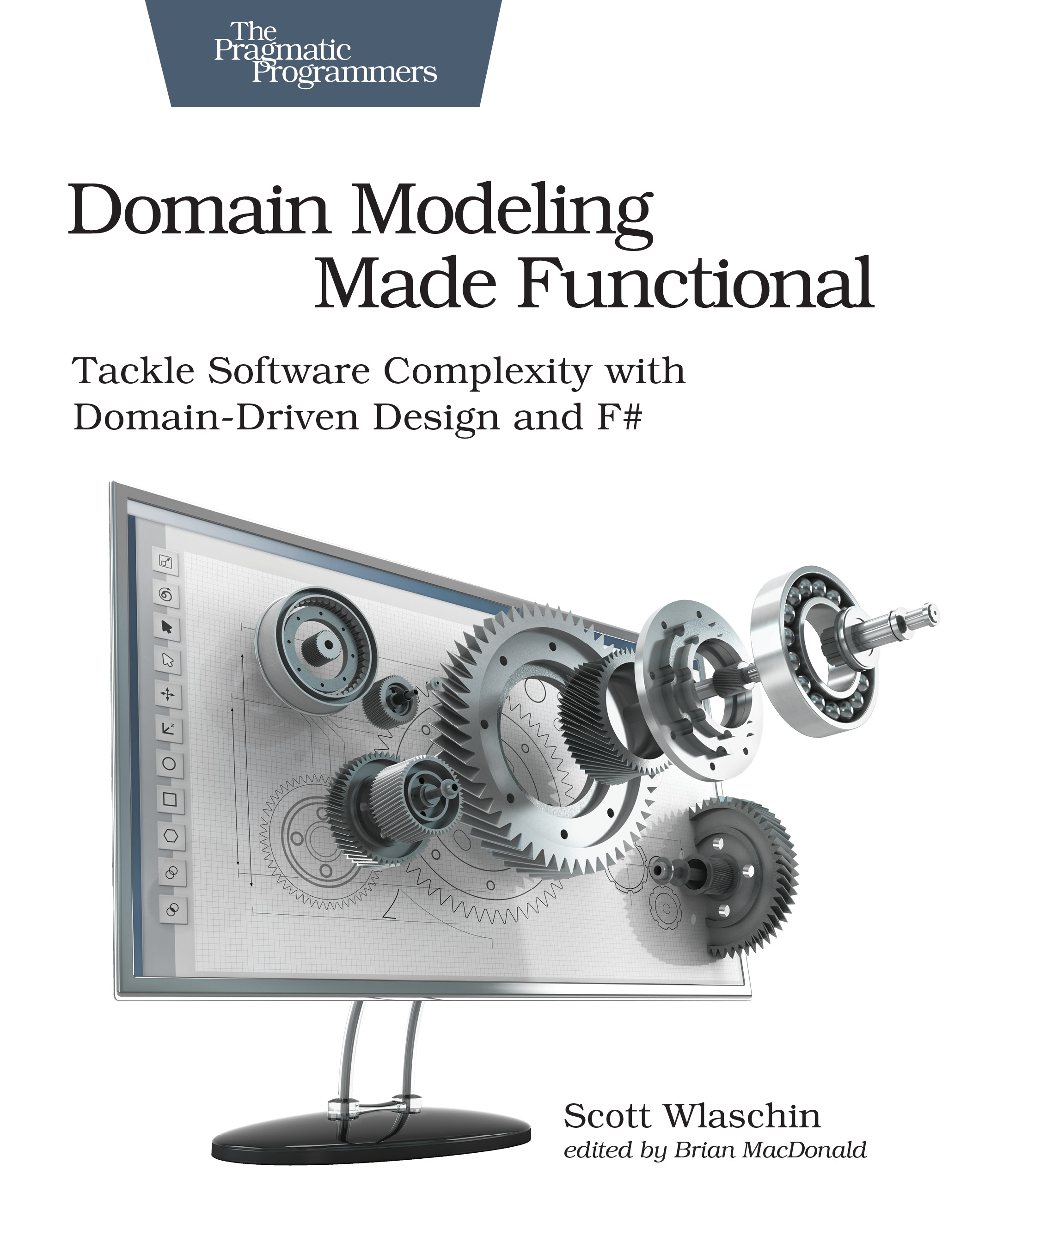
F# Resources - Books
Get Programming with F#
Domain Modeling Made Functional
Isaac Abraham
Scott Wlashin
https://github.com/srpeterson/fsharp-csharp-developers

Slide 15
F# Resources - Online
https://fsharp.org/ - Official F# site with mentorship program
https://exercism.io/ - Online training with a mentor
https://fable.io/repl/ - Online REPL with code samples
https://fsharpforfunandprofit.com/ - Scott Wlashin’s F# learning site
Google – just do a search for “Learn F#”
https://github.com/srpeterson/fsharp-csharp-developers

Slide 16
Thank you!!!
Don’t forget! All the code, info and slides are here!
https://github.com/srpeterson/fsharp-csharp-developers

